Slide 1
Nairobi 5-7 September 2018
ADMAG Meeting
Sahel Region
Disaster Management Overview
Notes:
PRESENTATION 2.3.1

Slide 2
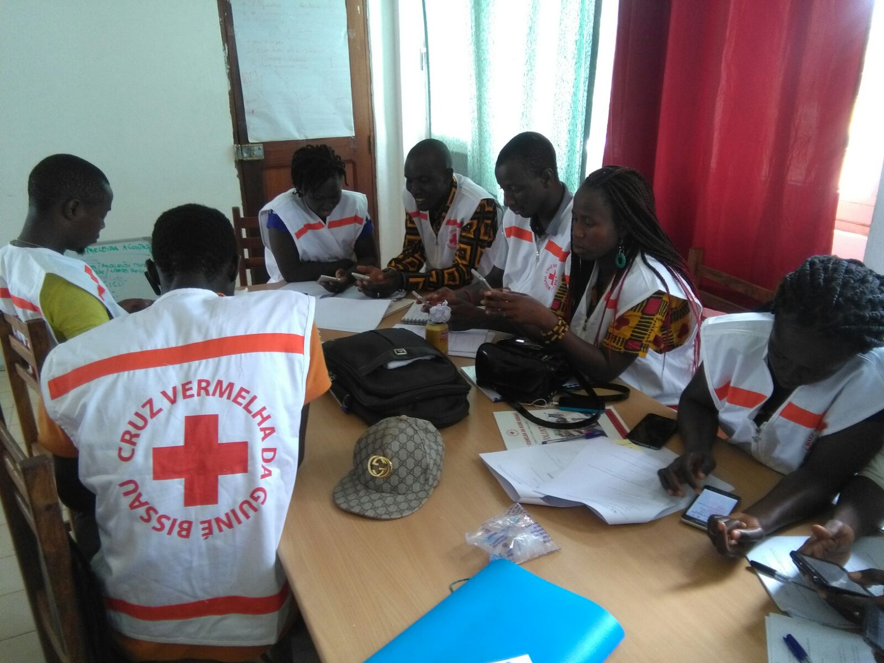
Presentation Outline
ADMAG in the Sahel
The Sahel Context for DM
Challenges
Opportunities
Propositions for way forward

Slide 3
ADMAG in the Sahel
Just starting – not yet any DM – Programme Group in Subregion
Groupe Sahel + - active and picking up – higher level representation
End of September in Bamako – first concrete chance to group DM-Programme Coordinators
Already apply principles of SMCC and Shared Leadership on regular basis

Slide 4
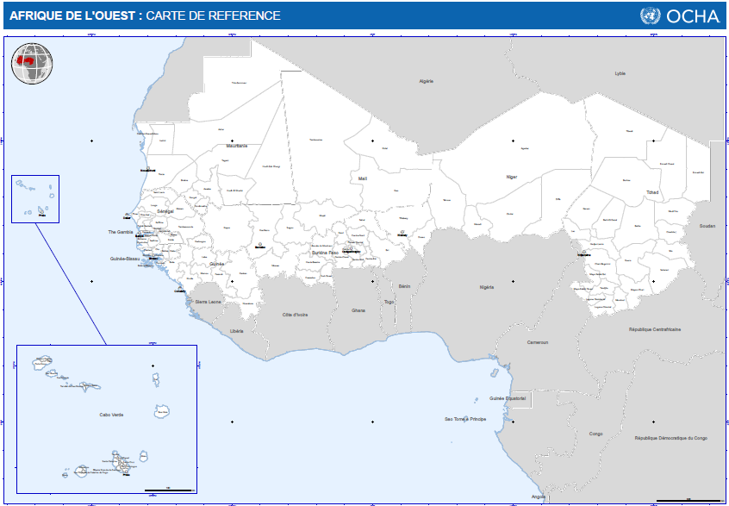
Area of Coverage Groupe Sahel +
Nine NS Covered by Sahel CCST:
Cap Vert
Gambia
Mauritania
Guinea
Guinea Bissau
Senegal
Mali
Burkina Faso
Chad
Plus Niger, covered by IFRC Delegation.

Slide 5
Sahel Context for DM
Hazards and Disasters
Chronic – Seasonal – Slow onset
Priority areas with high chronic vulnerability
At national level – mostly small to medium level of crisis
Various contexts of protracted / complex crisis (Mali – Chad – Burkina Faso)
Main IFRC operations: 1 Appeal Mauritania Food Insecurity – DREF (Floods – Population movement – Storm) and Shelter project
Presence of Movement Partners
Good presence of ICRC over Sahel
Limited presence of IFRC Secretariat
Good presence of PNS, but inequally distributed:
  High n. of partners in Mali, Burkina Faso, Senegal.
  Low in Mauritania, Guinea Bissau
  Harmonisation et coordination interne aux acteurs du Mouvement au sein du Group Sahel +

Slide 6
Sahel Context - Calendar

Slide 7
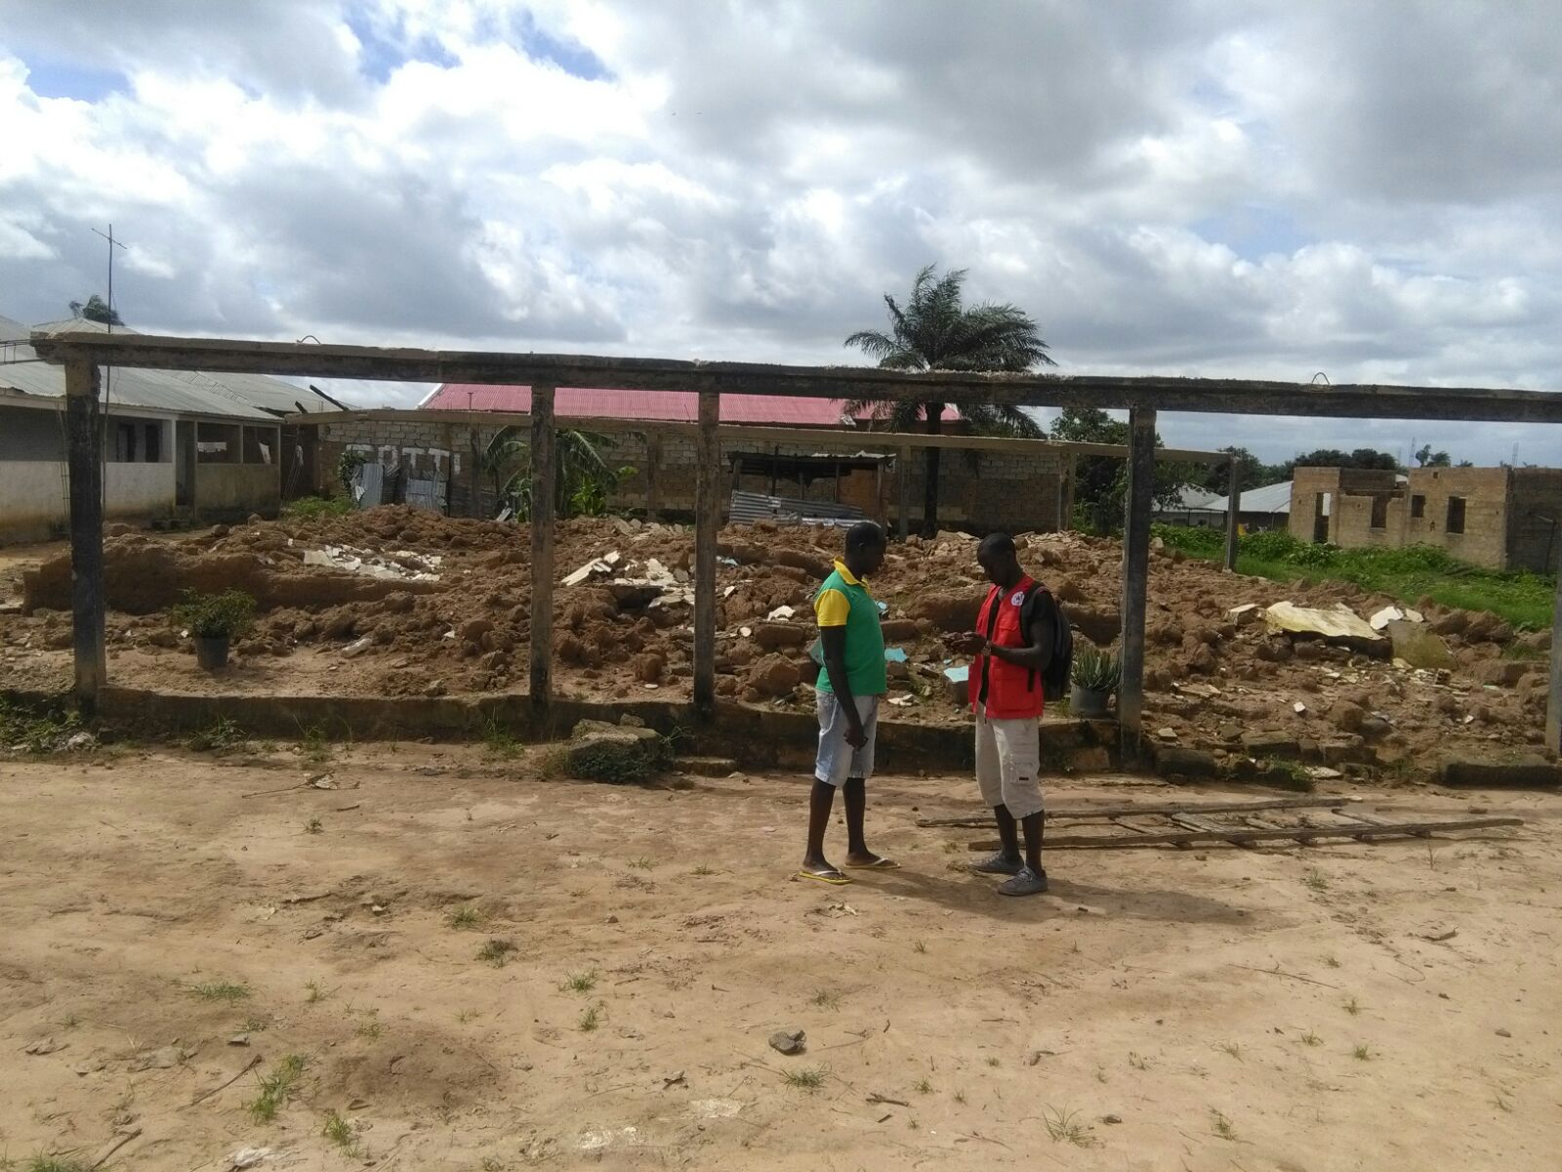
Key challenges
Limited resources compared to other regions
Available programme tools not yet adapted – properly used
Insecurity impacts operations and capacity to reach those in need securely:
  Need to invest more on NS
Francophone and Lusophone NS – limited tools
  New way for Surge

Slide 8
Main opportunities
Real potential to invest in anticipation – preparedness (Contingency planning – FBF – etc.)
Integrated approach for short-medium and long term programmatic tools:
  Discussion on common Resilience Approach for Sahel
    Harmonize Approaches Group Sahel +
    Focalize on priority areas and tools
    Key external partnerships
Will of Governance of NS to strengthen sub-regional approaches – Leadership of Groupe Sahel+ for Resilience Platform
  Key themes: Food Security – Migration – Shelter

Slide 9
Propositions for way forward
Strengthen SMCC collaboration on Security in context of limited resources – How?
  ICRC leadership for Movement?
  IFRC staff hired in region to ensure coordination and standard?
Increase participation of PNS in core DM functions (DREF)
Strengthen Movement focus on these thematics:
  Cross boarder approaches (peer to peer)
  Urban DRR – Needs and opportunities increase in cities -
    Focus investment on what branches?
Key needs:
  Roving Operation Manager / Officer
  Resilience Analysis and strategy
  FBF Officer
  Secondment of NS to IFRC (DM – Food Security – Shelter – Wash)
  Security manager

Slide 10
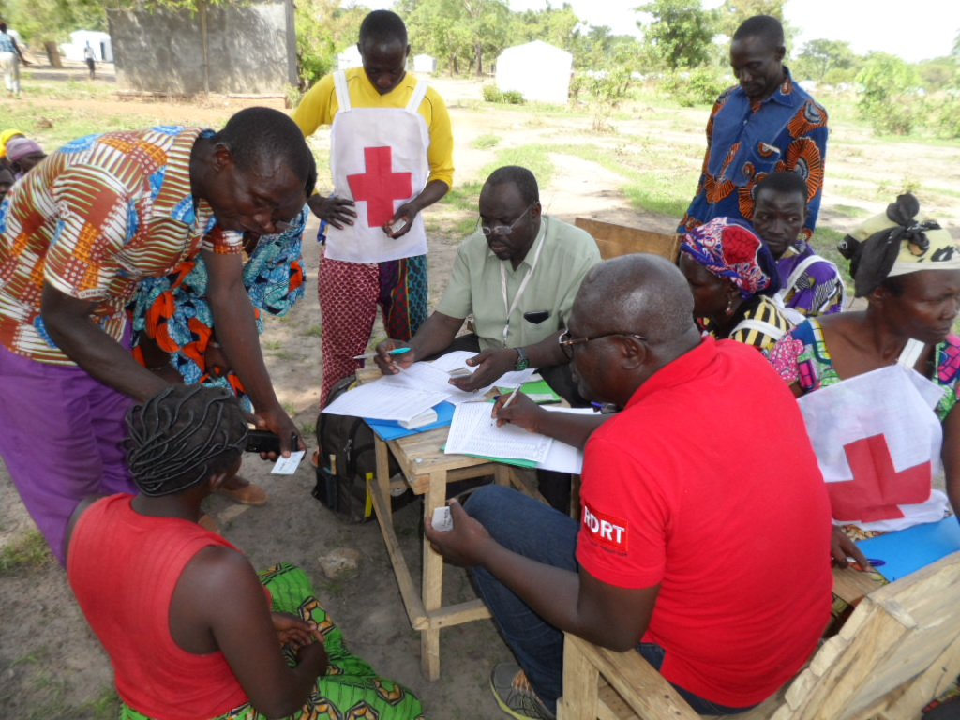
Thanks

